Slide 1
Chicago HOPES for Kids
Team Delta
IT 394 and IT 395

Slide 2

IT 394 and IT 395 - ASL Program
ASL - Academic Service Learning
Community engagement with course content
Experiential learning
Binds together Community, Academic learning and Civic learning
Vincentian values

Slide 3

Our Team
Shivangi Kakkar Team Lead
Jobelle Gramata Co-Lead
Syed “Wajji” Rizvi Training Manual Expert
Viral Thakkar Team Member
Aayushi Patel Team Member
Jay Patel Team Member
Daniel Hai Team Member

Slide 4

CHFK Mission Statement and Goal
“provide educational support for children living in Chicago's homeless shelters.”
Chicago HOPES for Kids (CHFK), ensures that students, despite the challenges of homelessness, can unlock their true potential and receive the necessary academic support they need in order to keep up with school.

Slide 5

Expected Approach
In order to successfully provide a positive environment to these homeless students CHFK needed a system that could help them stay organized and keep track of their progress.
Our goal was to find a Customer Relationship Management (CRM) system that could keep track of all their volunteers (a little over 250) – their hours, demographic information, requirements, certifications, etc. They also wanted to be able to create events, reports and timesheets for these volunteers.
Notes:
Once we gathered all the information, we analyzed different CRMs available, their cost, features and the user-friendliness (amongst other criteria).
We discussed our findings with our client and we collectively came to a conclusion that NEON was the best-fit CRM that met these requirements.

Slide 6
Project Plan
Our team implemented a new CRM system for Chicago HOPES for Kids. The new CRM facilitates different features such as volunteer tracking and event development by providing our clients with a cost effective and user-friendly interface.
Approach: Phase I: Client requirements and Project Charter Phase II: System Vision Phase III: Product Backlog Phase IV: User Stories Phase V: Sprint Cycles
Phase VI: Test Plans and User Testing Phase VII: Training Manuals / Deliver final product

Slide 7
Project Responsibilities
Each team members was responsible for ensuring that the Team completed the project. The Project Lead stayed in touch with the client via email/phone to ensure that the team got the necessary materials and information. The rest of the team was assigned individual project tasks based on the needs of the project as it progressed. Each member was responsible for communication, including status reporting, risk management, escalation of issues that couldn’t be resolved in the team, and, in general, making sure that the project was delivered on schedule and adhered to the client needs.
Notes:
Team and Client Communication ***
Completing assigned and schedules tasks
Status reporting and keeping elaborate documentation
Were some of the key elements responsible for the success of our project
We ran into many minor issues and setbacks throughout the completion of our project.
But overall we believe that with the help of our team members and team support, we were successfully able to deliver the project as per our client’s expectations.

Slide 8
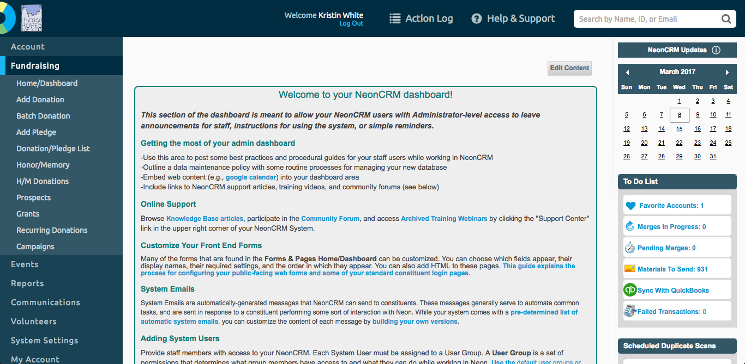
Chicago HOPES for Kids NEONCRM

Slide 9
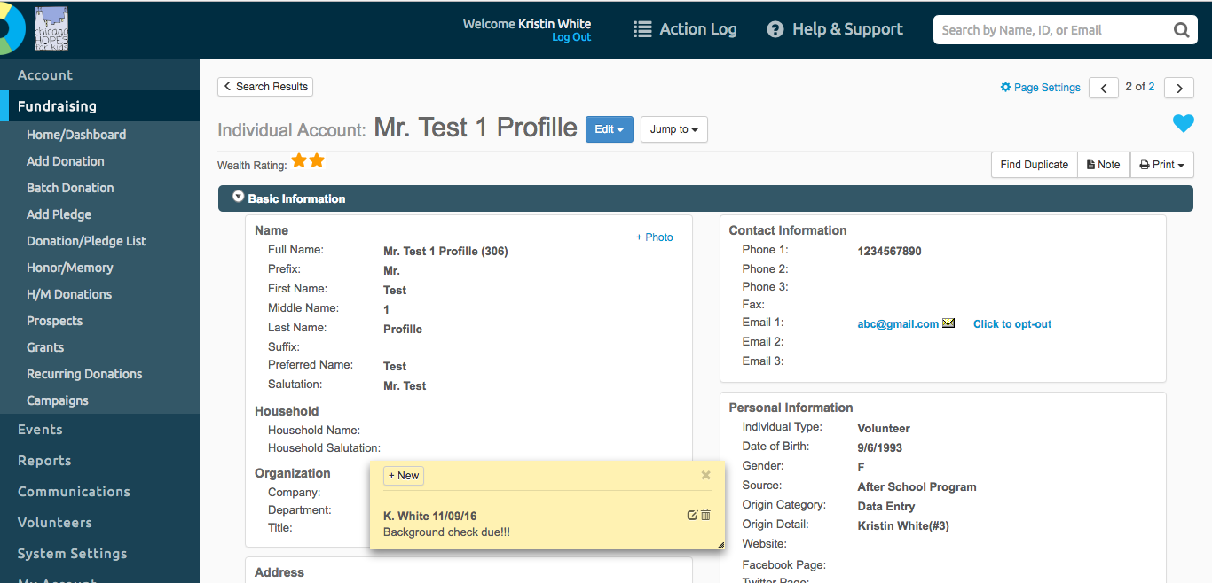
Volunteer Profile

Slide 10
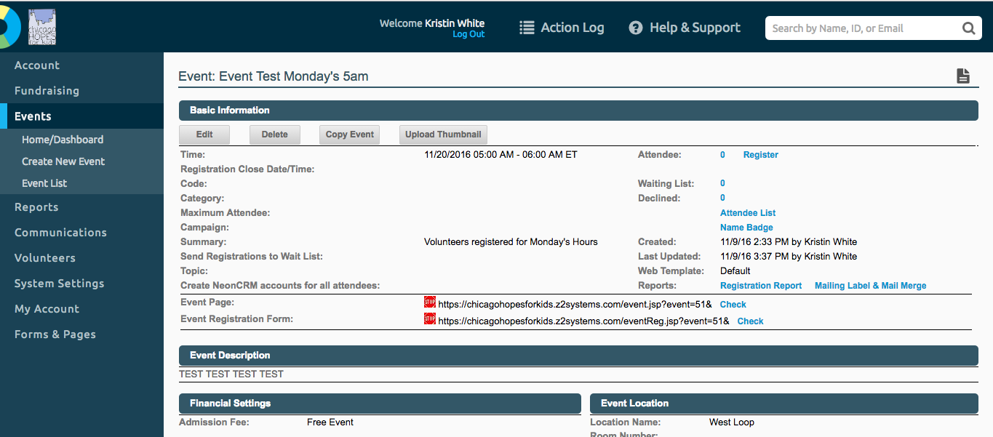
Events

Slide 11
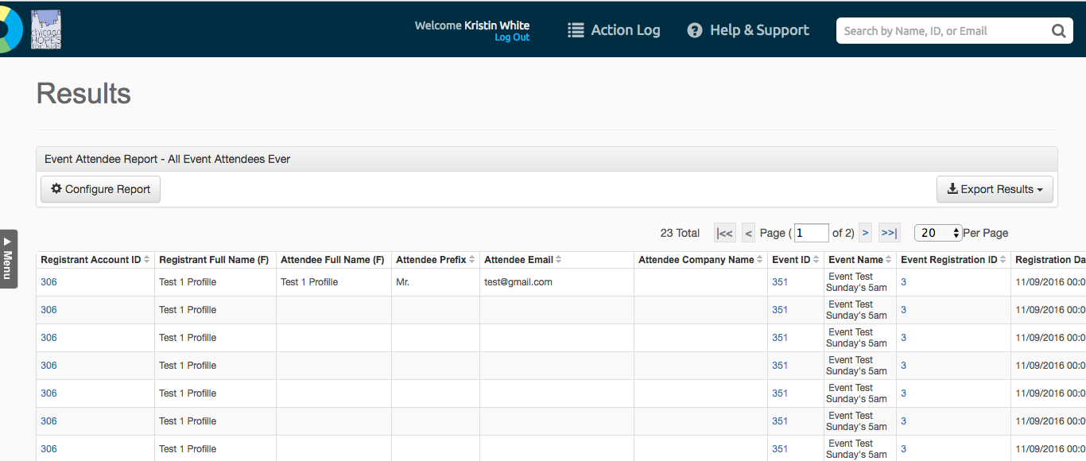
Reports

Slide 12
Summing - Up
With the help of Professor Chase and our team members we believe that we were able to help our community partner in their mission.
Not only did we learn about how real life projects work but we also learned how to deal with conflicts in a professional environment.
We worked together to overcome any adversity that we faced throughout the two quarters.
We would like to personally thank Professor Chase for making this an amazing learning experience. We would not have been able to succeed without his guidance and hands on teaching.

